Slide 1
Collaborative Source Code Review
Sprint 2
Team 17
Wenxuan Xu, Weitong Zhang, Jinyi Li, Jiaxin Chen

Slide 2
Goals for Sprint 2
Integrated with GitHub
  File from GitHub
  Login using GitHub
File Management
  Project Tree
Message Box
  Invite new users to review code
In-line Comments and Replies
Suggest as an user types in search bar

Slide 3
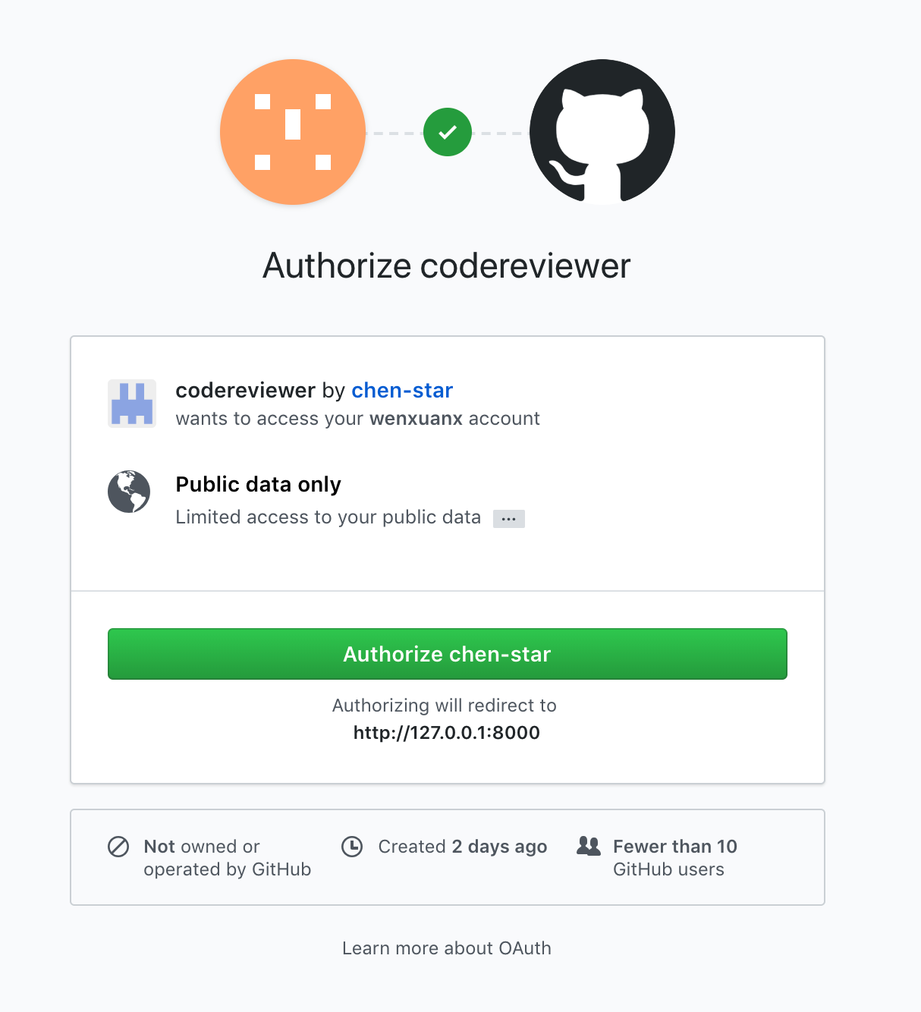
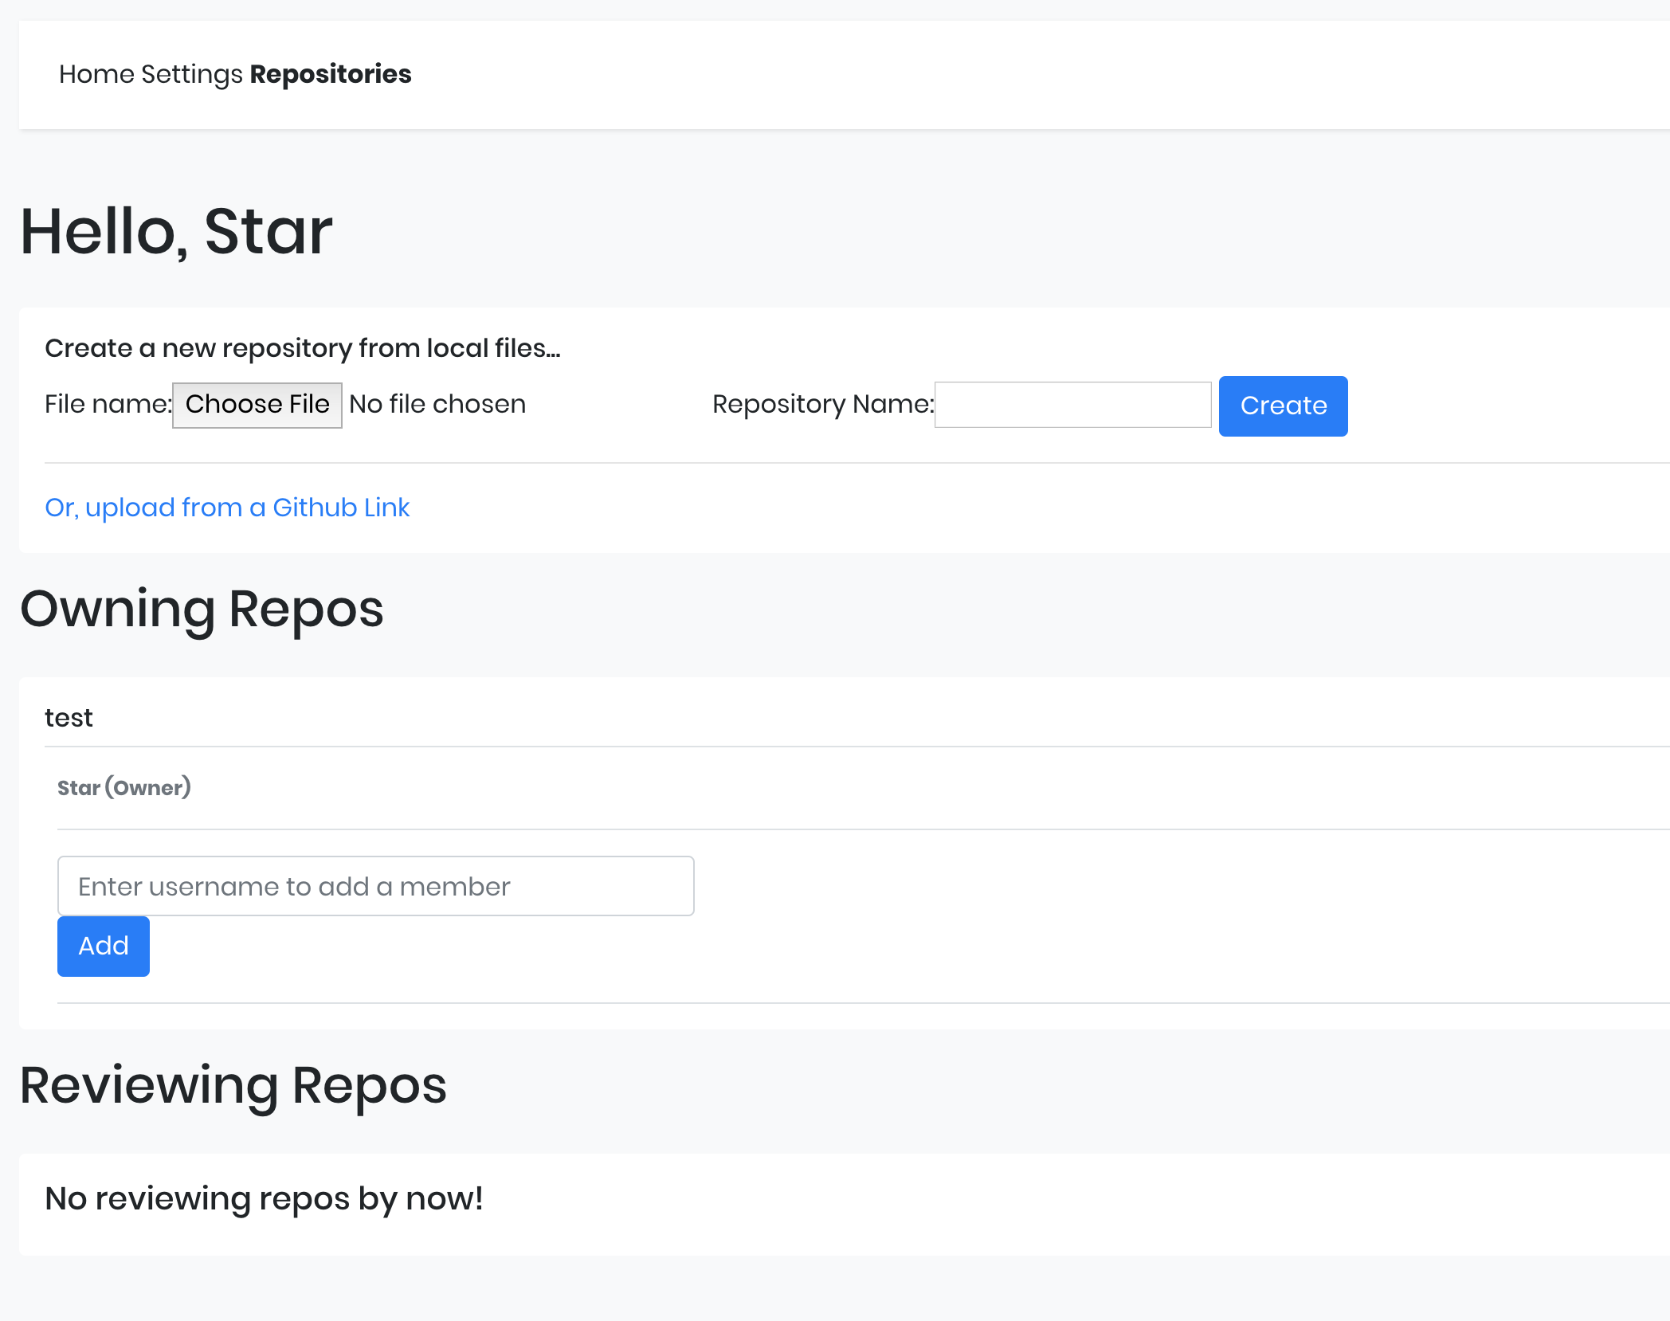
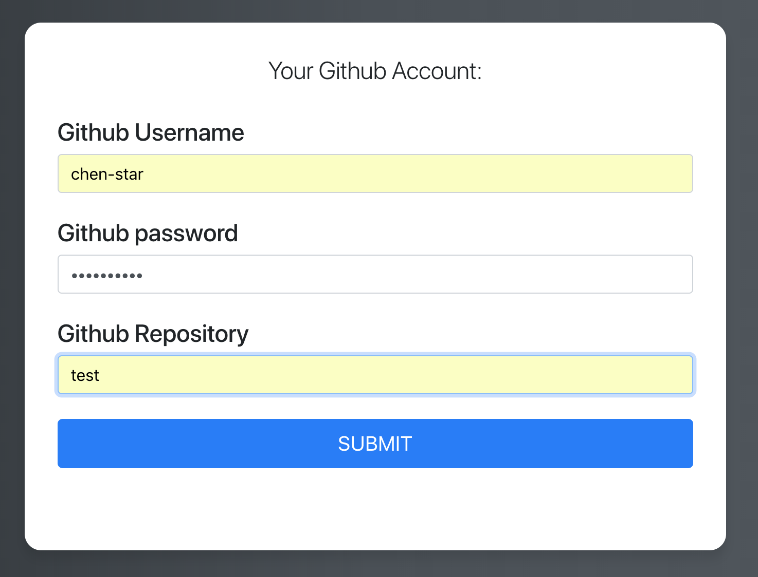
Integrated with GitHub
Login with Github Account
File from Github
There you have
Specify the repo name to import

Slide 4
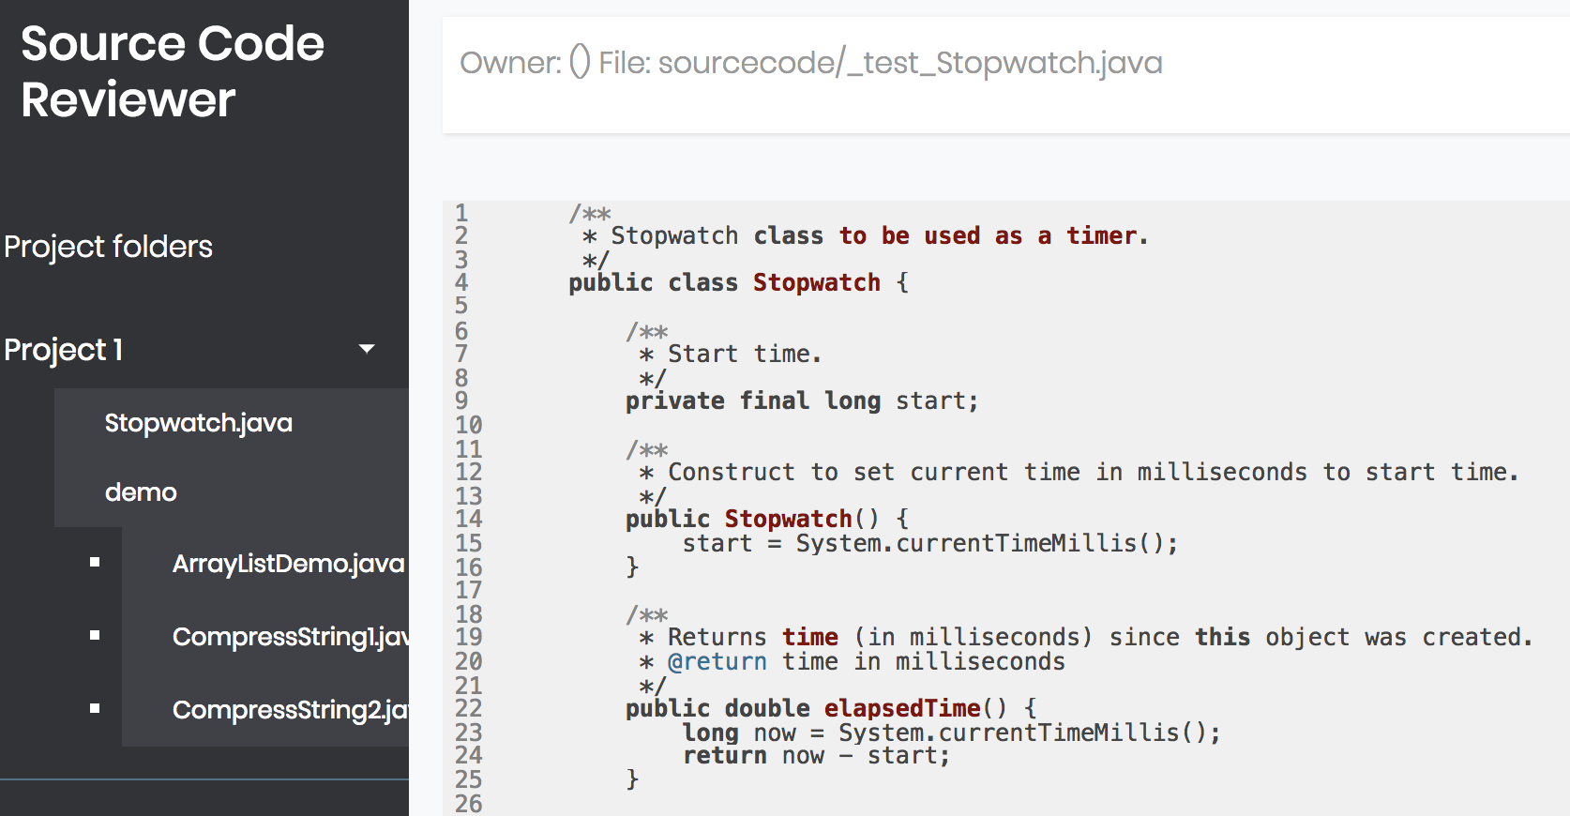
2. File Management

Slide 5
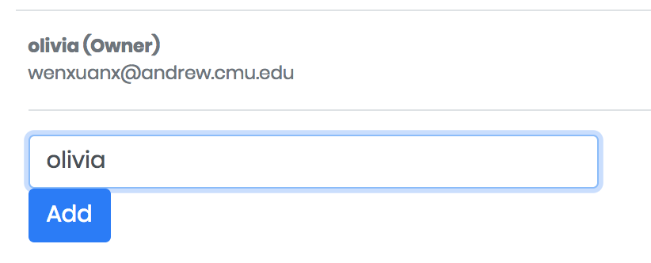
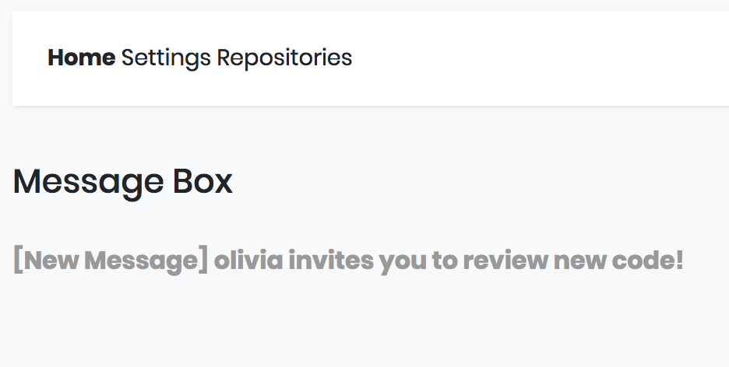
3. Message Box

Slide 6
4. In-line Comments and Replies
Click to expand and collapse the comment and reply block
Content is loaded when it is requested
  To improve the performance
Better experience when reviewing codes
  Not interpreted by comments

Slide 7
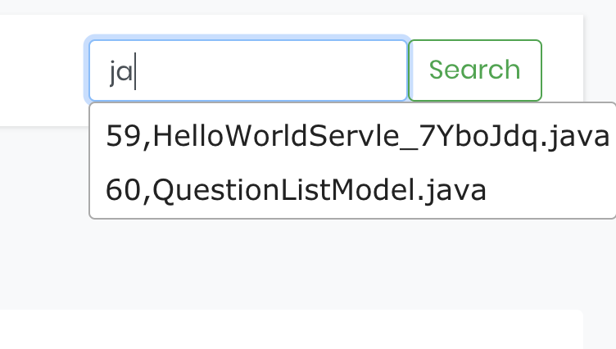
5. Search bar
Suggest as you type

Slide 8
Demo

Slide 9
Goals for Sprint 3
Fix Other Bugs and Improve Robustness
  Check existence and proper status code
Deploy to Cloud
  AWS and S3 file system
Perform User Tests
  And Modify our solutions accordingly
Prepare for Final Demo

Slide 10
Questions?

